Slide 1
SUPERMARKET SALES FORECASTING USING BIG DATA ANALYTICS AND MACHINE LEARNING
Team 6
Rajesh Ganapathy Sankar
Sathiyakailash S
Vidhya Kannaiah
Yagnaraman M
Laxmana Narayanan

Slide 2

Problem Definition
Suppliers
Grocery store:
Perishable items
Non-perishable items
Customers
Purchasing
Sales
Forecast Sales
Purchase decision
Over prediction:
Over stock leading to less space for selling items
Perishable goods resulting in losses
Under prediction:
Popular items quickly sell out leading to opportunity loss leading to customer dissatisfaction

Slide 3
Problem Definition
Current process:
They currently rely on subjective forecasting methods with very little data to back them up.
They have very little automation to execute plans.
Requirement:
They’re excited to see how machine learning could better ensure they please customers by having just enough of the right products at the right time.
Build a model that more accurately forecasts product sales.
Plan:
Get Raw Data (Corporocion – Kaggle)
Exploratory Data Analysis
Sample Data (Store 44)
Evaluation Metrics (RMSE)
Apply Algorithms (Time Series/ LSTM/ Regression)
Provide Insights

Slide 4
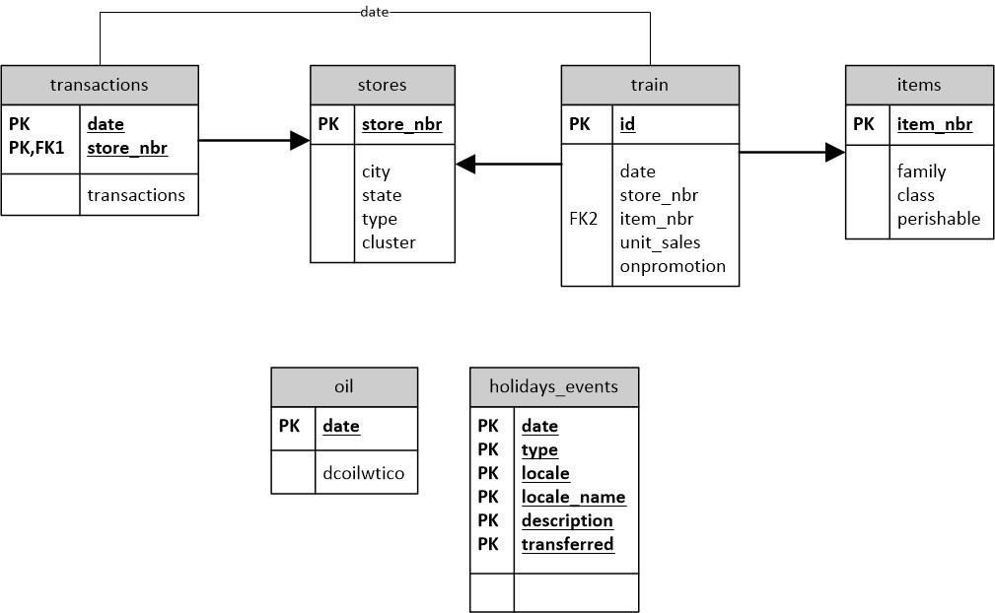
Data Model

Slide 5
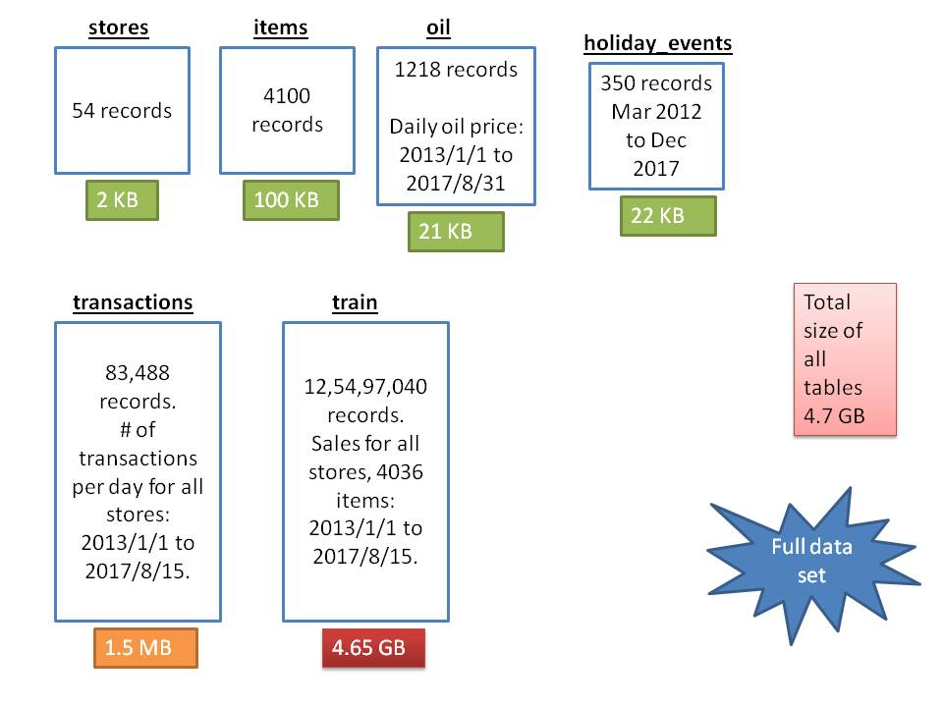
Data from Kaggle

Slide 6
Challenges
Data sets provided are huge. We needed to take only a subset of data.
After careful analysis, the following filter criteria were applied.
Train data was restricted to years 2013 to 2015.
Store 44 was chosen for the following reasons:
It is the store with top most transactions from 2013 to 2015.
It has transactions the most number (363) of days in a year.
It has good amount of sales of various items
holidays_events had duplicate holidays. Duplicate events had to be removed carefully considering the national and regional holidays.
Oil data had missing rows and missing values in columns. Data had to be generated via data frame interpolate (linear, treating the values as equally spaced).

Slide 7
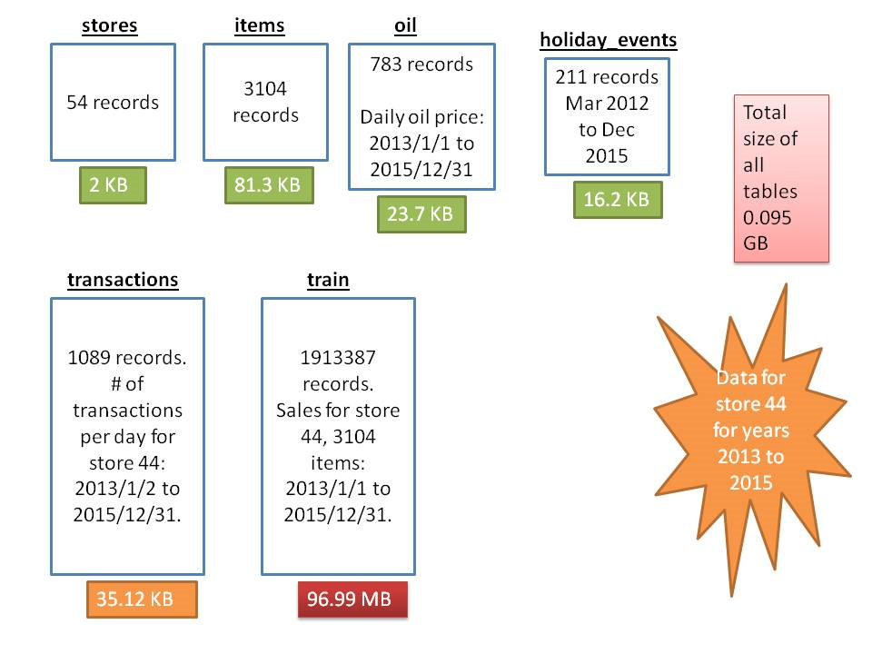
Data after filtering for store 44 and years 2013 - 2015

Slide 8
Data processing done
Table | Join of/Subset of (Semantically) | Comments
train_store44.csv | train (Subset) | Subset of train table having data for store 44 for the years 2013 to 2015.
transactions_store44.csv | transactions (Subset) | Subset of transactions table having data for store 44 for the years 2013 to 2015.
items_store44_2013_2015.csv | items (Subset) | Subset of items table having data for store 44 for the years 2013 to 2015.
holidays_events_2013_2015.csv | holidays_events (Subset) | Subset having data only for years 2013 and 2015.
holidays_events_2013_2015_noduplicates.csv | holidays_events (Subset, No duplicates) | Eliminated duplicate records in holidays_events_2013_2015.csv table.
oil_2013_2015.csv | oil (subset) | Subset having data only for years 2013 and 2015.
oil_2013_2015_interpolated.csv | oil (Generated data) | Generated the missing data in the oil_2013_2015.csv table, both for missing rows and missing values in columns.
train_store44_with_items.csv | train, items (Join by item_nbr) | Result of join between "train_store44.csv" and "items_store44_2013_2015.csv
train_transactions_daily_store44.csv | train, transactions (Aggregate, Join by date) | Joined train and transactions for store 44 (years 2013 to 2015). First the data in train was aggregated to date level regardless of the items and then merged.

Slide 9










Functional Architecture
Retail Core Systems
Key Input Dimensions
Forecasting/Modeling
Outcomes of evaluation loaded back to optimize the model
Customer relationship Management System
Operations Management System
Stores
Financial Management System
Items
Outcome: Predicted Sales
Inventory Management System
Sales & Marketing System
Promotio-nal Offers
Forecast/Predict
Sales
Customer Service & Support System
Oil Price
Supply chain Management System
Merchandise Management System
Actual Sales
Holiday Events
Historical Sales Transactions

Slide 10
Data Architecture
Data Sources
HDFS
Sales_Transactions_Raw
Stores
Oil Price
/raw
/hive
Items
Holiday Events
/processed
HIVE
Promotio-nal Offers
Sales Transactions
Hive Database : Grocery_Sales_Transactions_Raw
Total Hive Tables | 16
Format | TEXTFILE
Row Format | Delimited
Fields Terminated By | , (Comma)
Layers | Purpose
/raw | Raw files from source layer
/processed | Store Processed files
/hive | Store all the files that hive external tables access

Slide 11






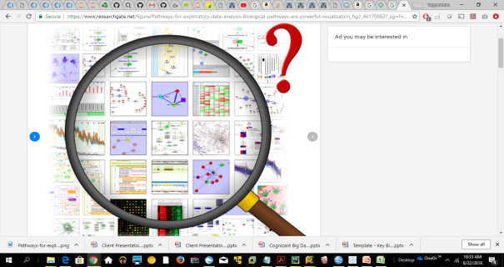
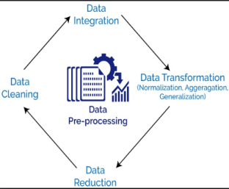
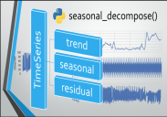
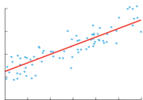
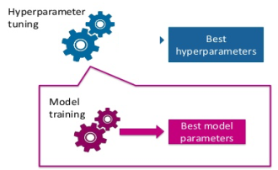

Solution Architecture
External Sources
Data Platform – Cloudera on AWS
Data Acquisition
Data Ingestion
Data Processing
Analytical Data Store
Visualization
Stores
Tableau
File Transfer
Sales_Transactions_Raw
Batch Mode
Oil
HDFS
Holidays Events
Pyspark & Python ML on Jupyter Notebook
Analytics Layer
Items
Exploratory Data Analysis
Data Pre-processsing
Modeling Layer
Model Optimization
Transactions
Time Series
Linear Regression
Train
Model Evaluation Metrics
1.DescriptiveStatistics
2. Visual Data Analysis
3. Missing value Analysis
1.Data integration
2.Data transformation
3. Data reduction
4.Data cleaning
RMSE
R2
LSTM
MAPE

Slide 12
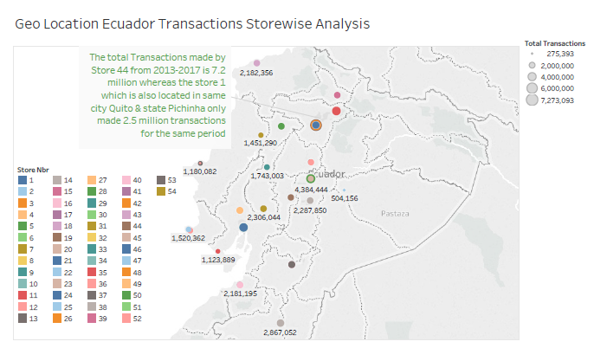
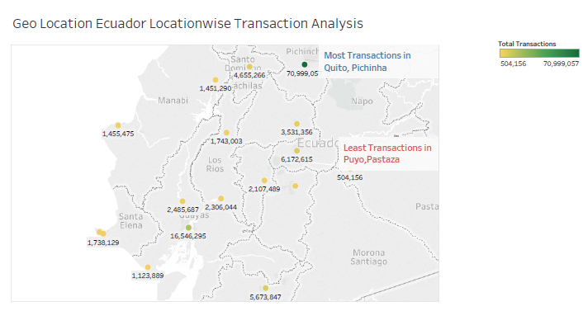
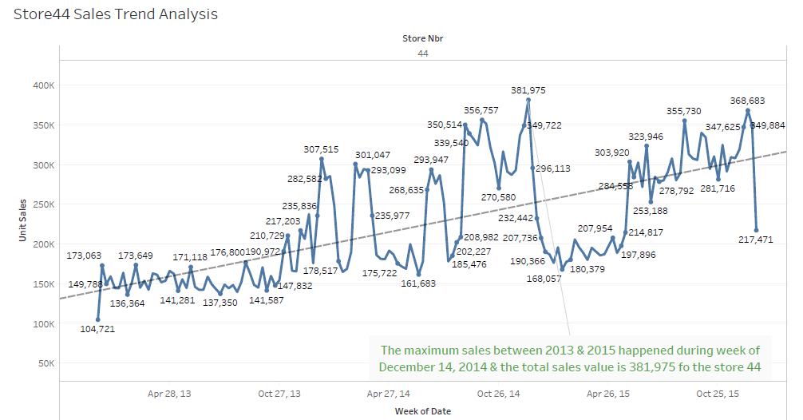
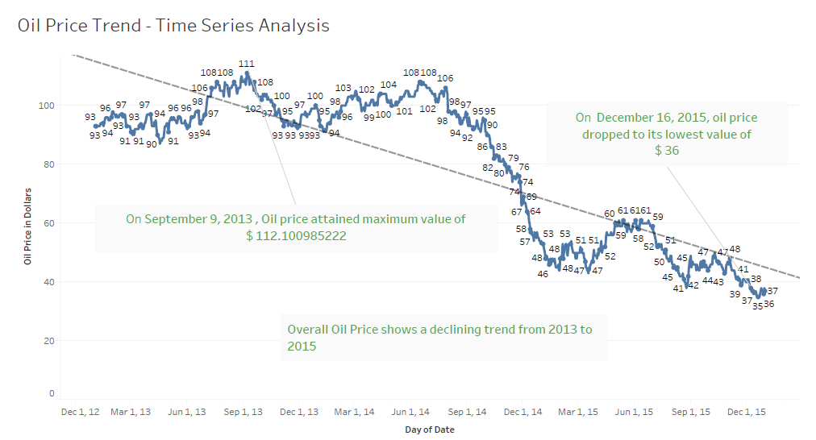
Exploratory Data Analysis

Slide 13
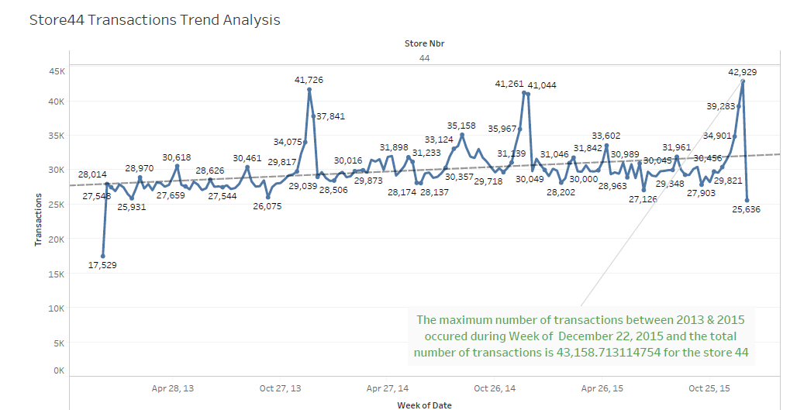
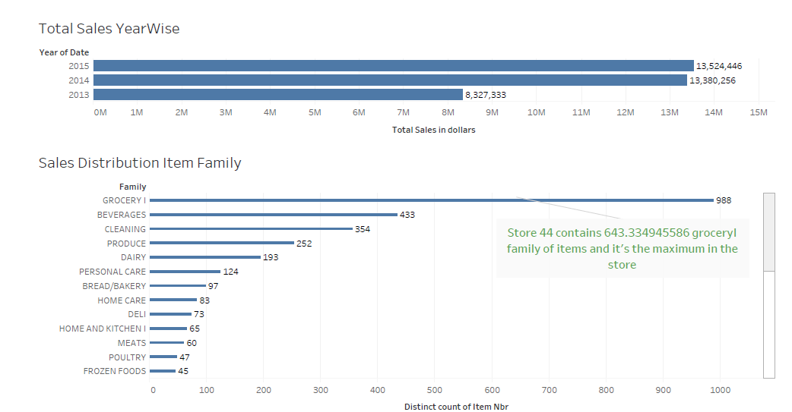
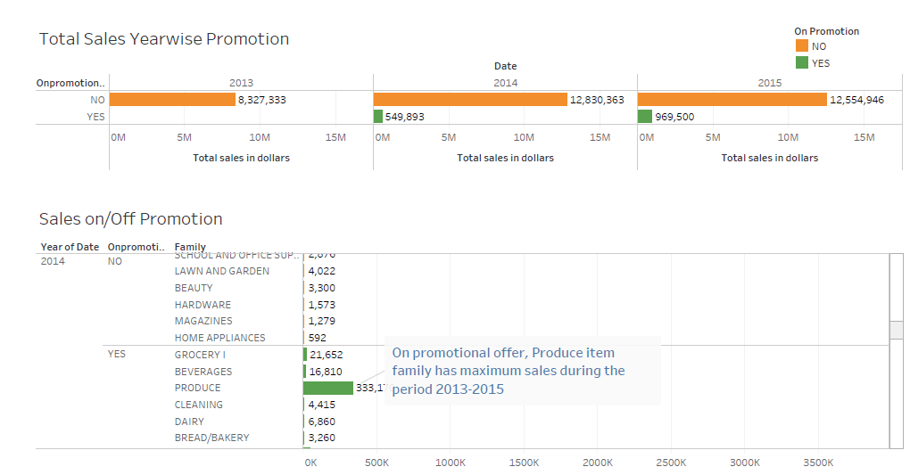
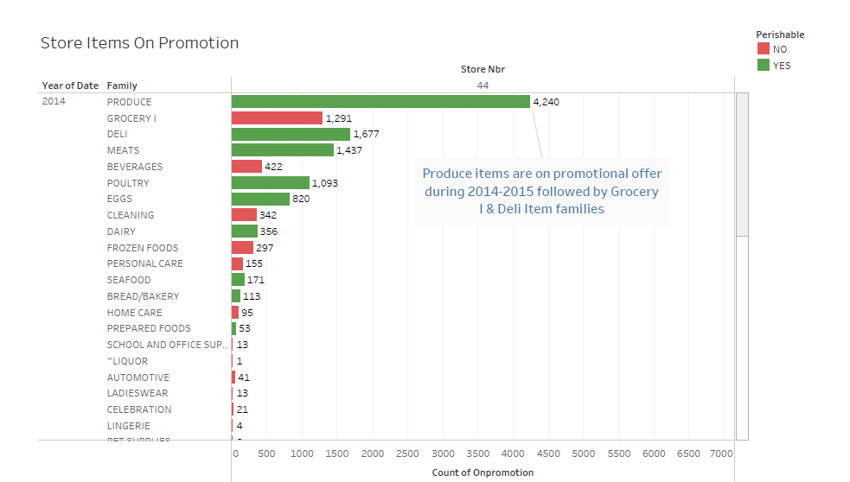
Exploratory Data Analysis

Slide 14
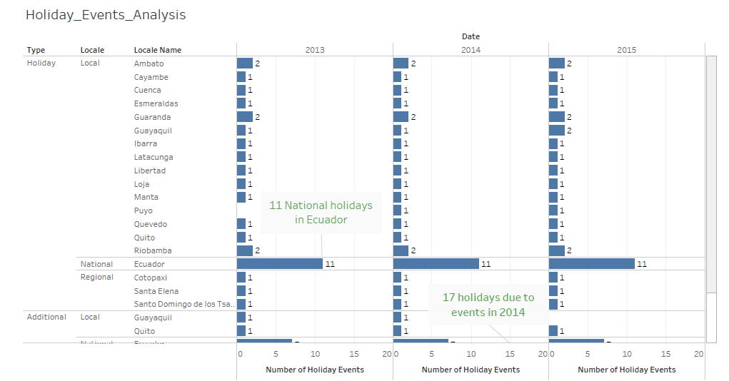
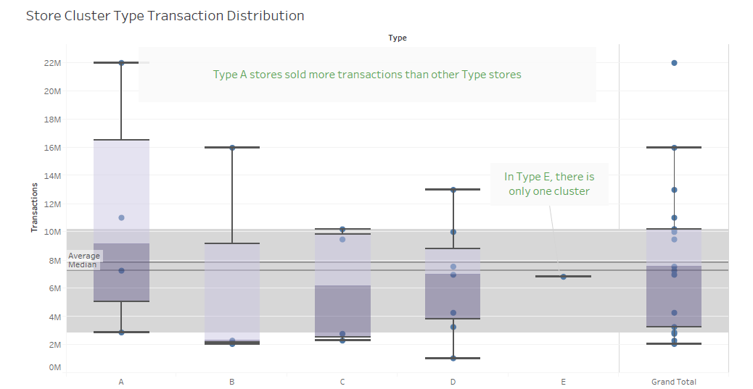
Exploratory Data Analysis

Slide 15
Suggested Solution
The key ask in the kaggle competition for the data provided is to predict the unit sales on daily basis. The transaction dataset has the unit sales on daily basis for each store outlet of Favourita supermarket chain. The salient features of the datasets are provided below.
The team has decided to go with a three pronged approach for the modeling to predict the unit sales.
Time Series Analysis – Use the unit sale alone as dependent variable and predict the time outcome of the same for the future time frame. The following models are tried out.
ARIMA
AUTO ARIMA
Sulekha – Holtwinters
Facebook Prophet
Regression – Use the holiday and oil data along with the train and transactions file and predict the unit sales.
LSTM – Apply Deep Learning algorithm to find out whether the model gives better RMSE and predictions than the previous models.
Based on the model outcome metrics (RMSE) and also the prediction plots, the best model will be chosen and presented.

Slide 16
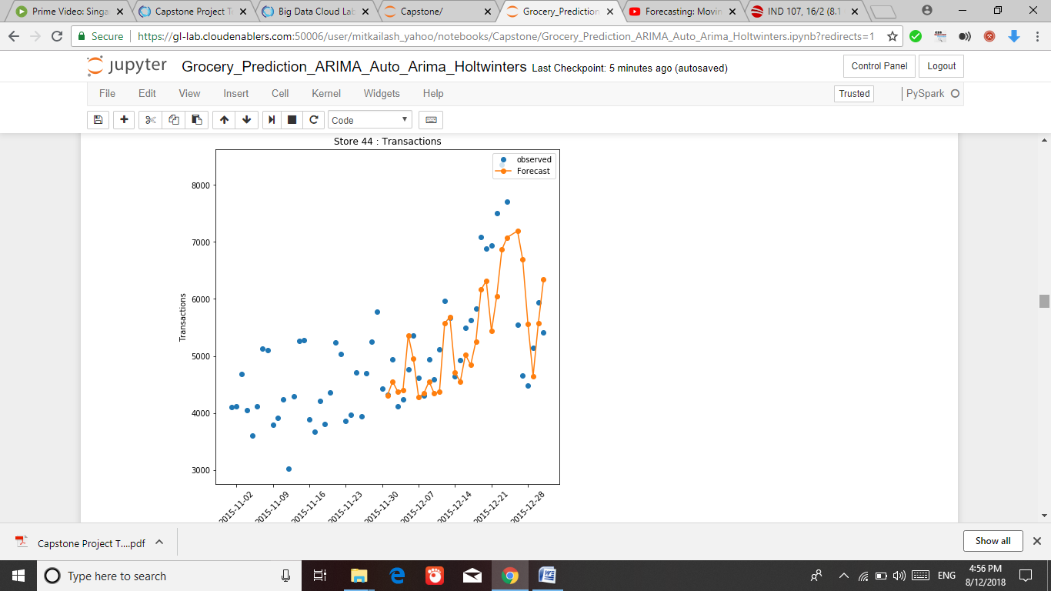
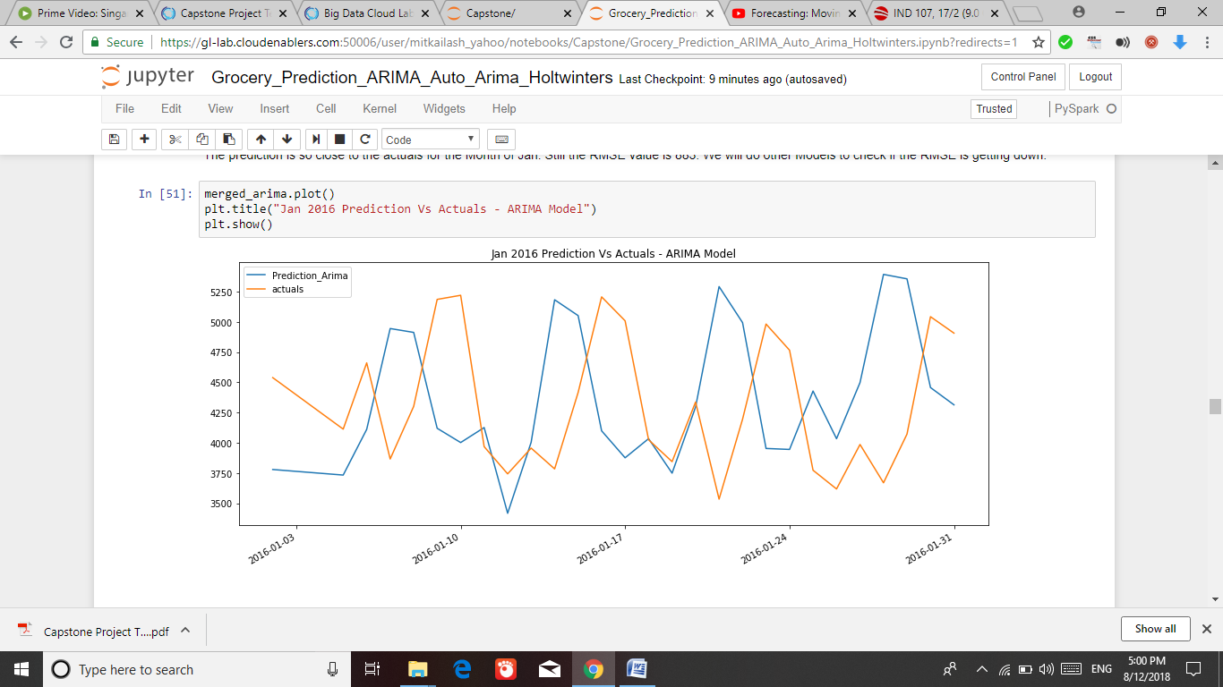
Algorithms – Time Series
We have applied the time series algorithms ARIMA and Auto ARIMA first. ARIMA stands for Auto-Regressive Integrated Moving Averages and it helps to predict unit sales on a future time series
ARIMA
The time series with the sale dates and Unit sales from the transaction file was fed to the ARIMA model after initial analysis, with the PDQ values of 5,0,5 and frequency of Daily (D).
The training was done on 2013-2015 data and the prediction was done for 1 month for Jan 2016. The actuals were compared with the output.

Slide 17
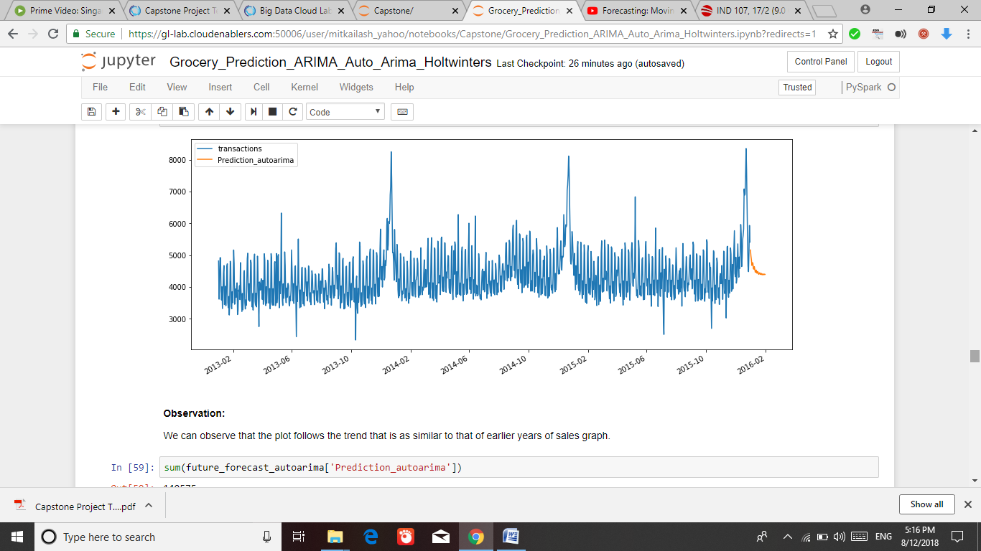
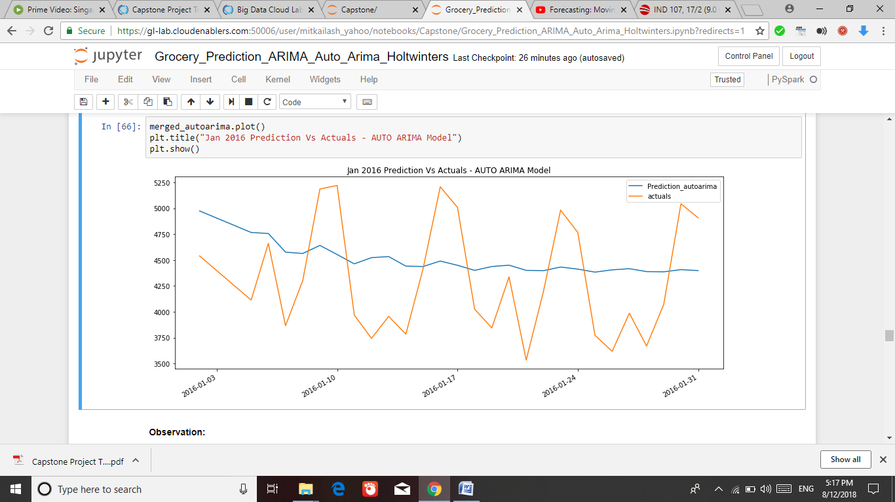
Algorithms – Time Series
AUTO-ARIMA
There are a couple of issues with the ARIMA we faced. It required the trial runs for various PDQ parameters and it is a time consuming process to execute.
Also, the grid search CV implementation is kind of difficult with the lab environment as there is a timeout issue.
Hence Auto ARIMA was tried out and the output of prediction was not the best compared to ARIMA but the RMSE was better than the previous models.

Slide 18
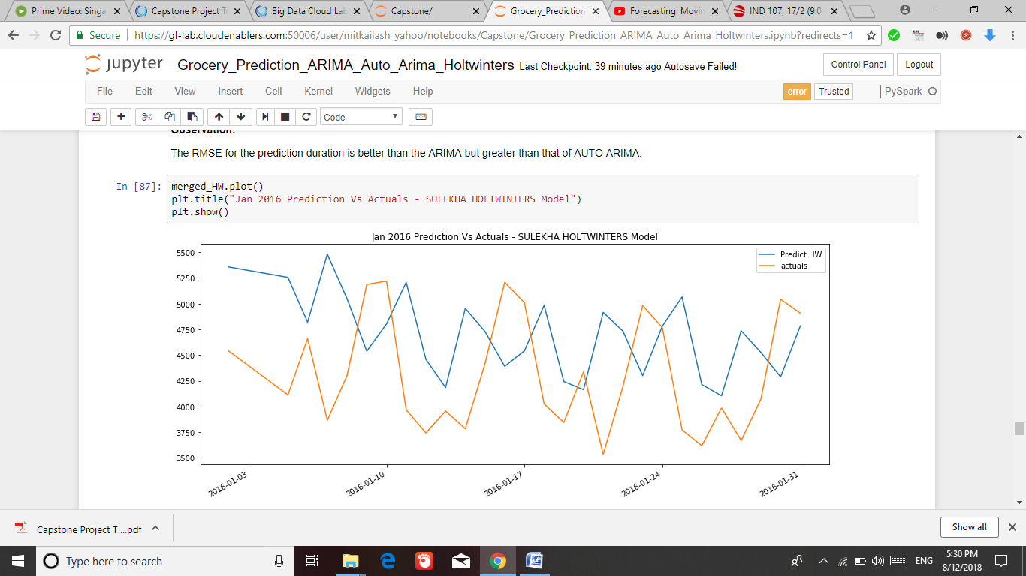
Algorithms – Time Series
Sulekha-Holtwinters
The next model tried was Holtwinters implementation (Sulekha-Holtwinters).
The prediction is done by using the holtwinters.additive function. The best fit parameters are found out using BestFit_Additive() function available along with the model. Again, 31 days of prediction is expected out of the below.
The output seems to be better than that of the AUTO ARIMA, there are some closer match between the predicted and actuals. The RMSE of Predict Vs Actuals is also at the lowest than that of AUTO ARIMA and ARIMA models.

Slide 19
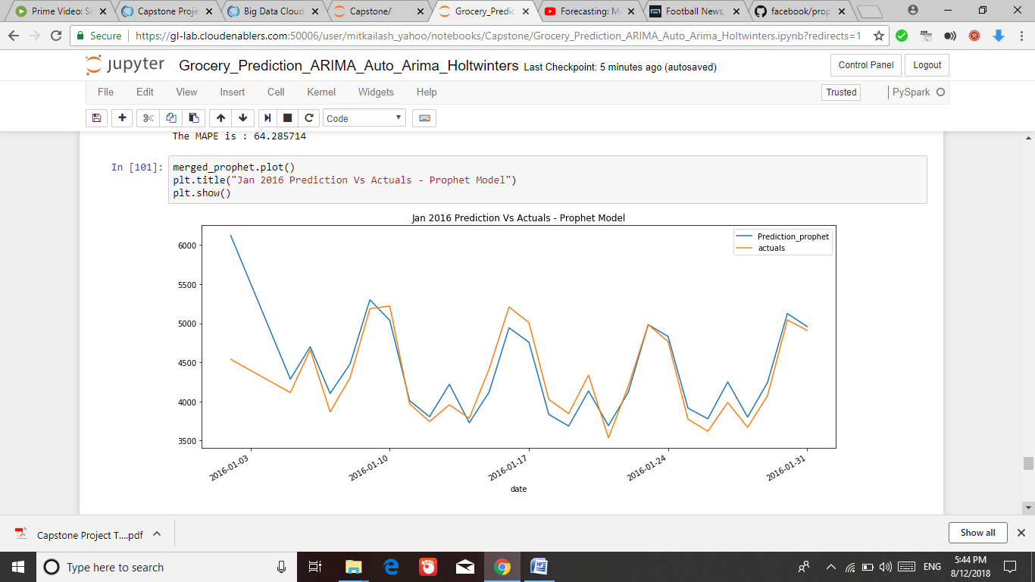
Algorithms – Time Series
Facebook Prophet
Facebook Research team has provided a tool for producing high quality forecasts for time series data that has multiple seasonality with linear or non-linear growth.
Prophet was tried with the time series data we have to predict the unit sales.
A future dataframe of 31 days has been created and the log time series is provided for predicting the actual.
The RMSE for the Actual Vs Prediction is 342, which is the lowest of all the models.
The graph of Actual Vs Prediction for Jan 2016 data from prophet has been the best among all other time series models.

Slide 20
Algorithms – Regression
We have applied the following regression algorithms to predict the sales:
Linear Regression with the normal function
Linear Regression with stochastic gradient descent optimization
Decision tree with gridsearchCV
Decision tree without gridsearchCV
Random Forest with gridsearchCV
We hypothesized that oil price plays a pivotal role in predicting the sales along with seasonal factors.
The statistical significance test was conducted and it was found that there is a significant relation between oil price & total sales.
Linear Regression with the normal & SGD Optimization:
The aggregated monthly Sales transactions data along with the oil price & holiday events are merged and fed as input to the model after performing data pre-processing. Train & Test split is 65:35.
Model was created using Linear regression function and R2 score was calculated and the RMSE metrics showed significant error > 0.60 and hence SGD optimization was applied using SGDRegressor Function and there was a reduction in error and improvement in R2 score but with no significant difference.

Slide 21
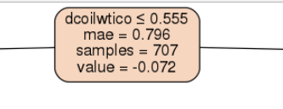
Algorithms – Regression
Linear Regression using decision with & without gridsearchcv :
Linear regression model was created by invoking the decision tree regressor function with the criterion as mae.
Metrics: mean absolute error, mean square error & root mean square error on test data were calculated and R2 score was computed.
The model decision tree performed poorly than linear regression.
We want to optimize the decision tree model by tuning the hyperparameters.
Hence we optimized it by applying gridsearchcv and the decision tree performed better than linear regression though on the much better scale.
The decision tree was generated and decision tree showed that the Oil price is the contributing factor in predicting sales and is at the top of the decision tree criterion.

Slide 22
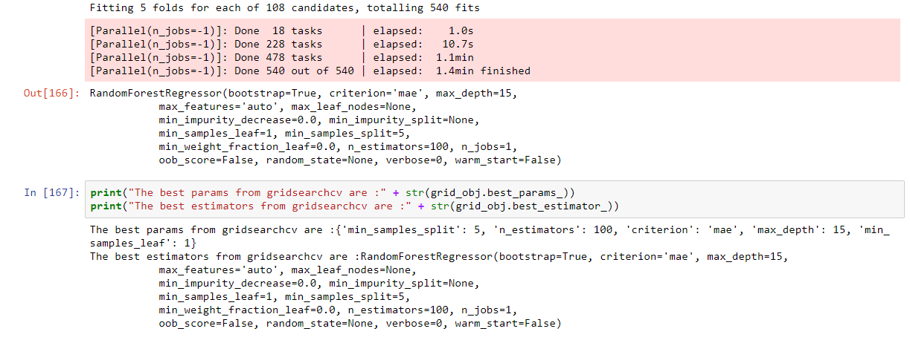
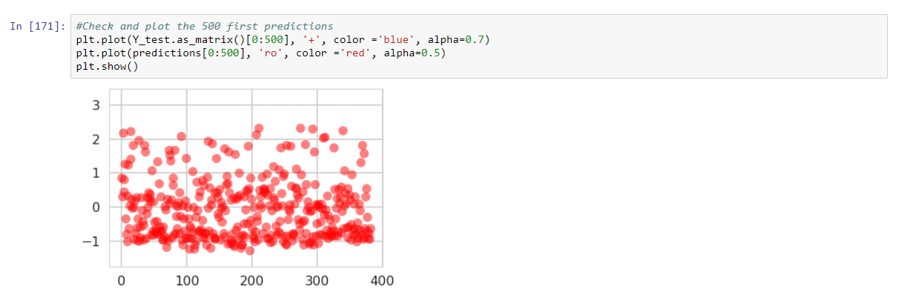
Algorithms – Regression
Linear Regression using Random Forest with gridsearchcv :
Linear regression model was created by invoking the random forest regressor function with gridsearchCV
Gridsearchcv found the best hyperparameter combination and calculated the R2score. There was significant improvement in R2 score and error has also significantly reduced from >0.6 to 0.5.

Slide 23
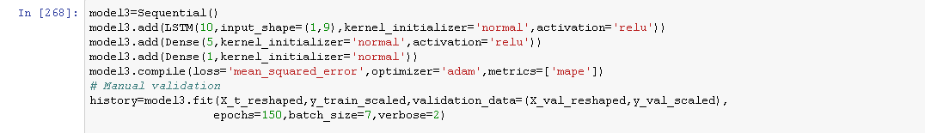
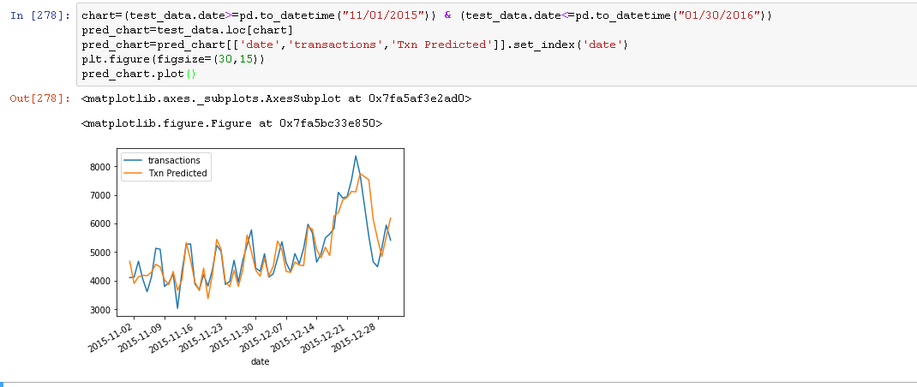
Algorithms – LSTM
Further, We extended our prediction with Deep Learning - Long Short Term Memory(LSTM) Model to forecast the Transactions.
After the dataset has been subjected to initial preparation, it is split standardized & rescaled.
The LSTM model follows architecture with- 10 memory units & 2 dense layer with single value prediction.
The prediction and RMSE were comparable with Prophet but the later one being the best.

Slide 24
Results Comparison
For the Model evaluation, we have used RMSE as the main metrics and MAPE. The table below provides the RMSE/MAPE values for the different models we have used.
Algorithm | RMSE | MAPE | Time Taken
ARIMA | 883 | 50 | ~10 Min
AUTO ARIMA | 553 | 71 | ~ 4 Min
Sulekha-Holtwinters | 800 | 71 | < 1 Seconds
Prophet | 342 | 64 | ~ 5 Seconds
The RMSE for Prophet has been the best of the lots. Also the Actual Vs Prediction plot output has been the best from Prophet Model.
For regression Random Forest algorithm provides the best RMSE.
Algorithm | R2 Score | RMSE | Time Taken
Linear Regression | 0.49 | 0.57 | < 20 Seconds
Linear Regression with SGD | 0.45 | 0.58 | < 30 Seconds
Decision Tree without GridsearchCV | 0.42 | 0.65 | <30 seconds
Decision Tree with GridsearchCV | 0.59 | 0.56 | < 1 min
Random Forest with GridsearchCV | 0.68 | 0.50 | < 1 Min
Algorithm | RMSE | MAPE | Time Taken
LSTM | 376 | 56 | ~ 25 Seconds

Slide 25
Results - Implications
The Prophet model has the most accurate prediction of the unit sales data.
The retail super market chains can leverage the model to predict the unit sales for the items and plan their inventory accordingly.
As an extension of the modeling, the team has tried to predict the unit sales of the top 10 items using the training data where there are item wise unit sales values for each day.
The predictions were then compared against the actual data available with us.
The plots created out for the top 10 items predictions were convincingly well matched.
Hence, the super market chains can use this for different aspects like,
Next day sales prediction of store item and top 10 selling items.
Monthly sales prediction
Weekly sales and the inventory need to stock up.

Slide 26
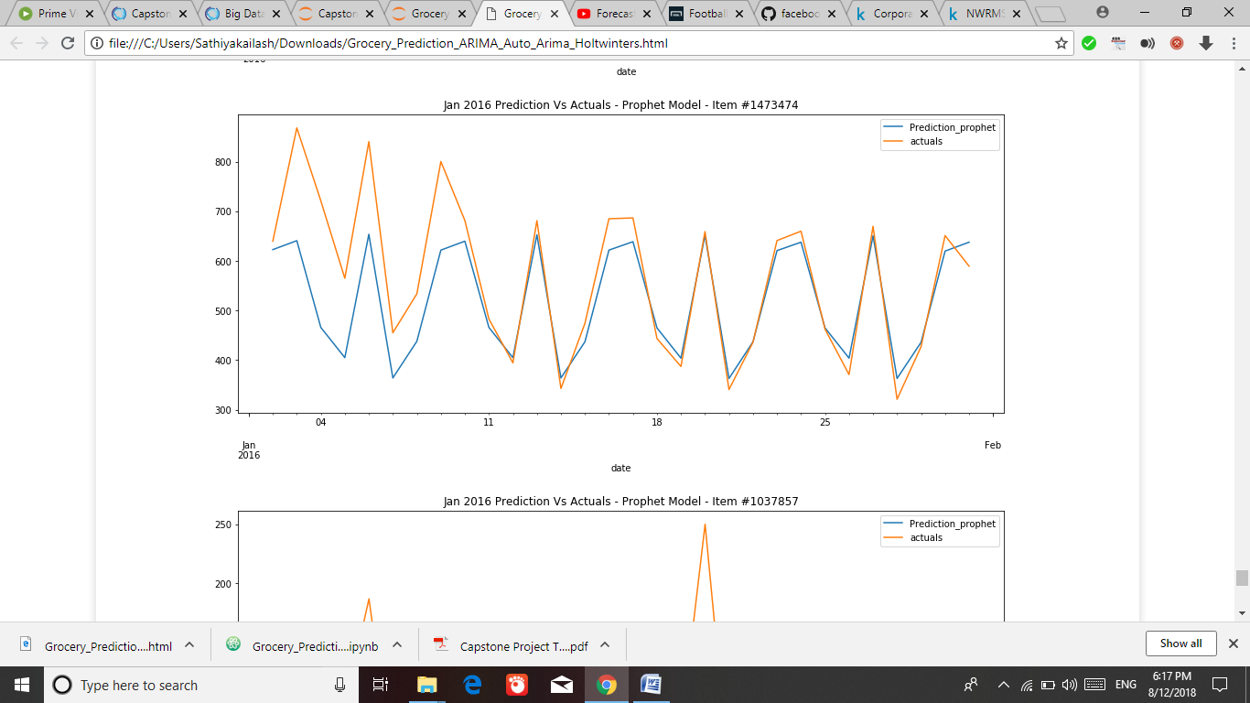
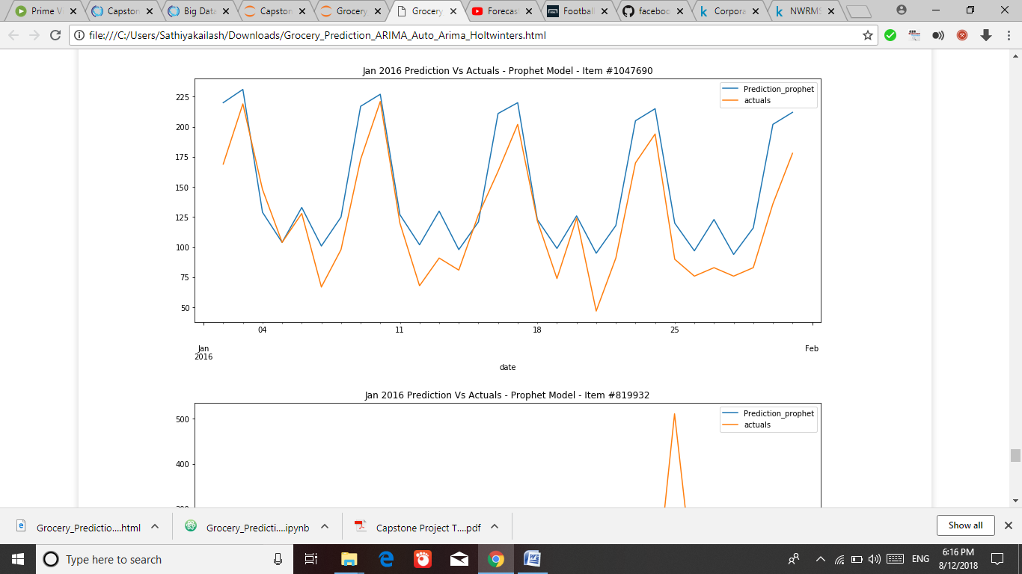
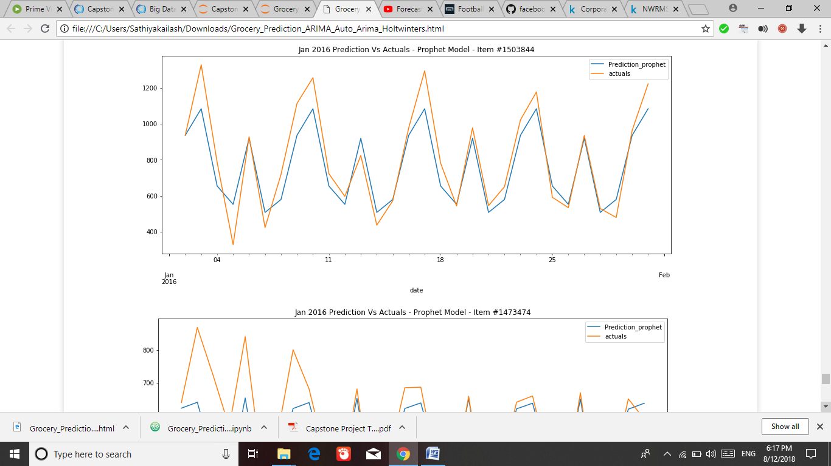
Results – Items prediction plots

Slide 27
Model Comparison – Pros & Cons
Models | Pros | Cons
Time Series - ARIMA | Transparency and uniformity of calculations and model’s construction. Relatively not complicated model construction. | Large number of parameters required to be determined. It’s difficult to set the best parameters for the fit to get the best forecast. Execution time is more than the other models.
Time Series – Auto ARIMA | ARIMA model with the best parameters can be determined easily via AIC criterion. Robust than simple arima model | Unstable when fed with new sets of observations. Relatively slower in terms of execution than customized holt winters and prophet model
Time Series – Customized Holt Winters | Easy to apply. Gives more significance to most recent observations. | Produces forecasts that lag behind the actual trend. Relatively slower than Prophet model.
Time Series – Facebook Prophet | Produces accurate forecasts. Automatically finds seasonal trends and parameters are easier to understand. Best execution time. | Absence of Transparency
Regression – Linear & SGD | Simple & uniformity of calculations. Transparency of intermediate calculations. | Works well only case of linear relationship & strong correlation between dependent & independent variables.
Regression – Decision Tree with GridsearchCV | Easy to explain to the business user the different conditions under which outcome is predicted, simple & easy to build | Works better with GridsearchCV but almost on par with Linear regression with SGD optimization but didn’t produce accurate forecast. Slower than other Linear regression models.
Regression – Random Forest with GridsearchCV | Robust and gives the best results in the linear regression algorithms category. | Didn’t produce accurate forecast. Lots of hypertuning parameters and hence need to rely on GridsearchCV. Slower than other Linear regression models.
RNN - LSTM | Great scalability & ability of parallel computations. Can also deal with non-linear relationships. | Absence of Transparency. Large number of parameters and significant options need to be selected.

Slide 28
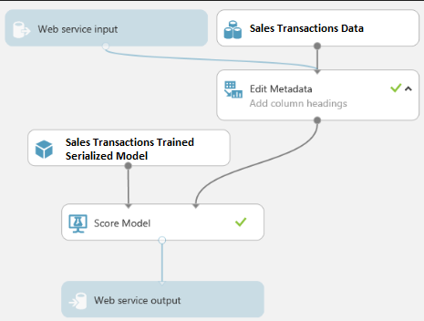
Productionize the ML model
To Productionize the ML Model – Use Joblib and serialize the objects in python.
Create a simple web application for the store manager to feed the date and get the prediction.
Provide options like daily, weekly or monthly prediction to get the total overall sales and the top selling items.

Slide 29
Thanks!

